Slide 1
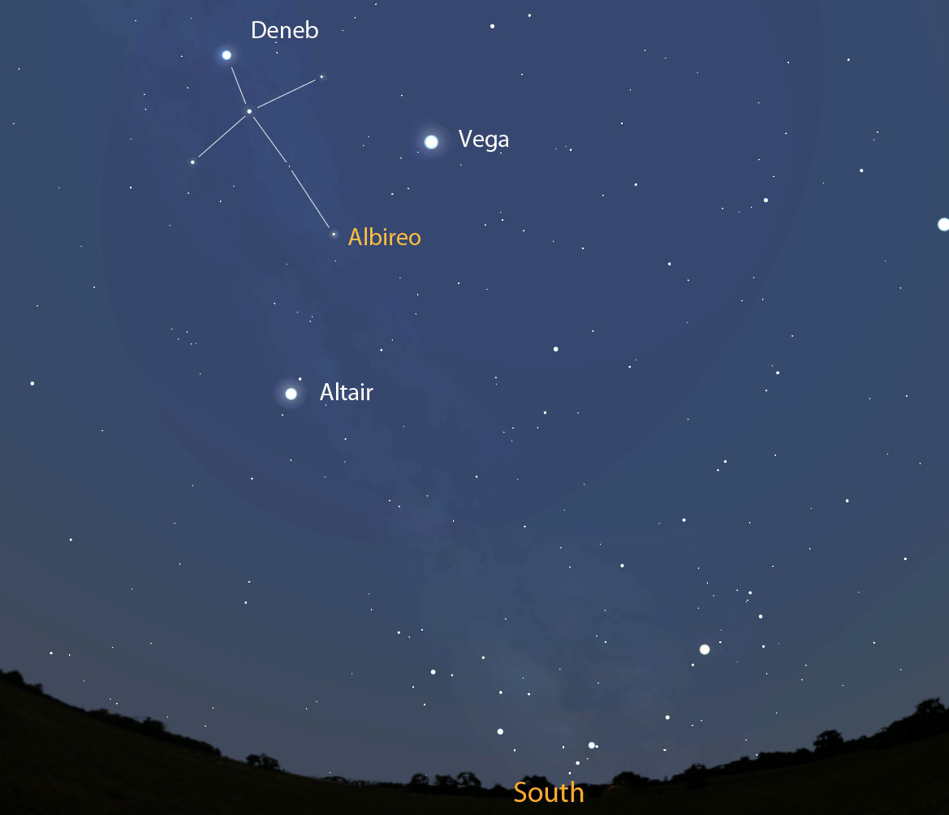
Albireo
Other Names:
Beta Cygni
The “beak star”
In Arabic, Minqar al-Dajajah, meaning “the hen’s beak”

Slide 2

This is a 3rd magnitude double star in the constellation Cygnus (the Swan). It is actually the 5th brightest star in Cygnus.
Albireo

Slide 3
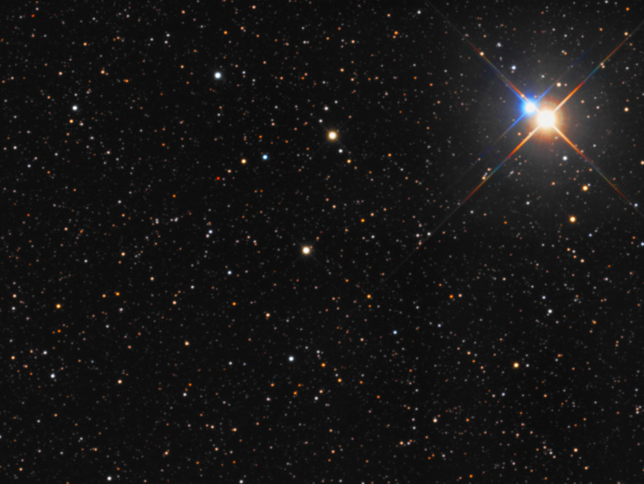
Albireo
430 light years away
Light we’re seeing left in 1586 AD:
1580 - Sir Francis Drake completes his circumnavigation of the globe…his is the 2nd journey to do that and the first under the same commander.
1582 – Shakespeare marries Anne Hathaway
1580s – Chocolate is introduced commercially to Europe
1587 – English settlers arrive at Roanake Island in North Carolina and re-establish the deserted colony

Slide 4
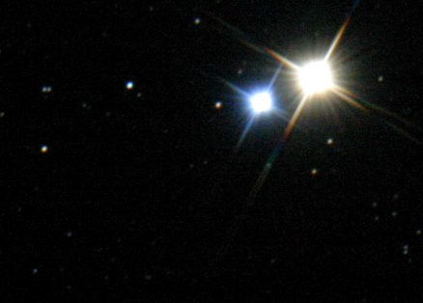
Albireo
They are separated by 4620 AU*
If they are orbiting each other (we don’t know for certain), their orbital period is at least 75,000 years
*AU stands for Astronomical Unit. One AU is the distance from the Earth to the Sun.

Slide 5
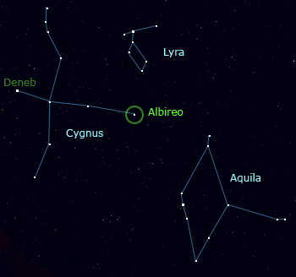

Slide 6
Albireo A
The golden amber star
Type: Orange, K3II, bright giant
Luminosity: 1460 Suns
Diameter: 66 Suns
Temperature: 7440⁰ F
Magnitude: -3.16

Slide 7
Albireo A
The golden amber star
In 1976, it was discovered that Albireo A is a binary system in itself, separated by 40 AU, and orbiting each other every 100-200 years. Our telescope can’t distinguish between them.

Slide 8
Albireo B
The blue white star
Temperature: 20,100⁰ F
Type: B8Ve, main sequence
Luminosity: 229 Suns
Diameter: 3.88 Suns
Magnitude: -1.15

Slide 9
Albireo B
The blue white star
It completes a rotation about every 14 hours.
This is a very fast spinning star, rotating at 150 miles per second.
The rotation causes a gas disk around it.

Slide 10
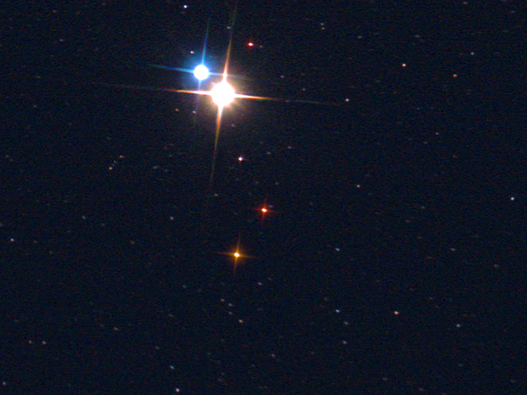
Albireo B
Albireo A
Giant Orange
1460 Suns
66 Suns
7440⁰ F
-3.16
Main Sequence
229 Suns
3.88 Suns
20,100⁰ F
-1.15
Type
Luminosity
Diameter
Temperature
Magnitude

Slide 11
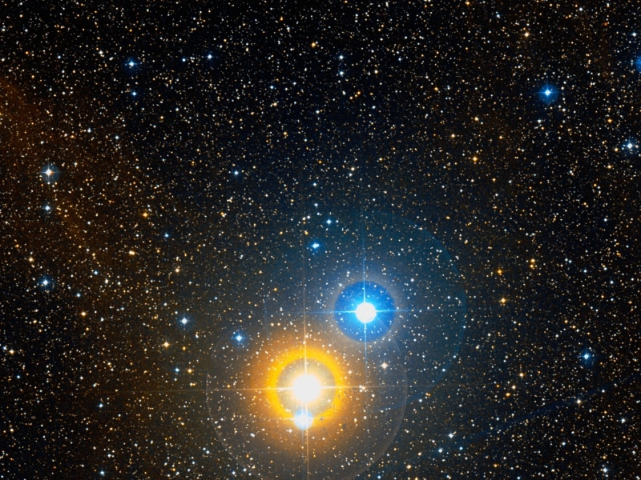
From Albireo B, Albireo A would appear as brilliant orange and blue points about ½ degree apart. The orange star would shine with light equal to about 35 full moons, and the blue/white companion about ½ half that.

Slide 12
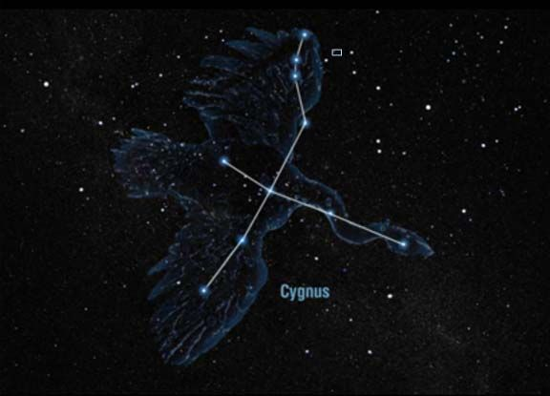
Albireo: the “Beak Star”

